Slide 1
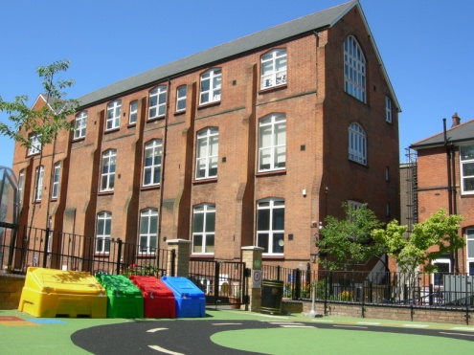
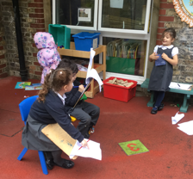
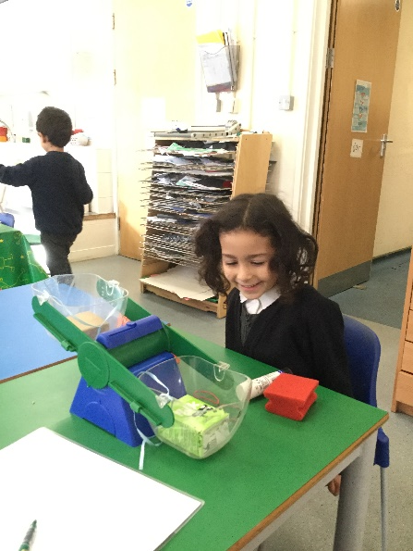
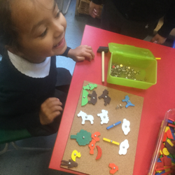
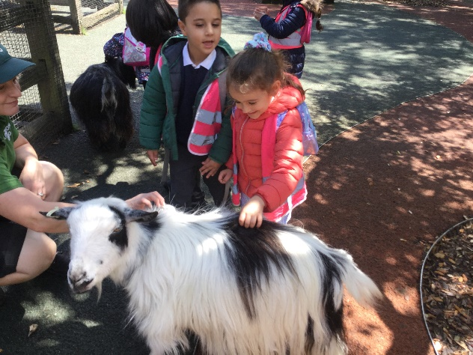
Applying for a Reception place
Primary school entry from September 2024 (Reception class)
If your child was born between 1 September 2020 and 31 August 2021, he or she will be starting Reception in primary school from September 2025.

Slide 2
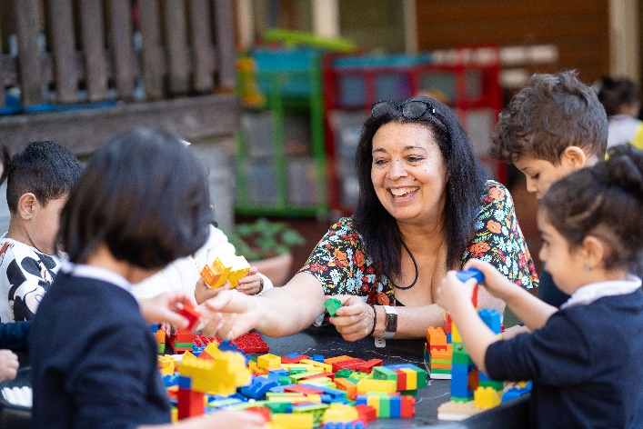
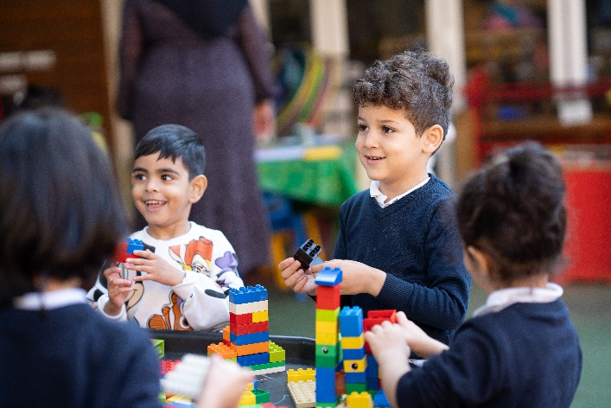
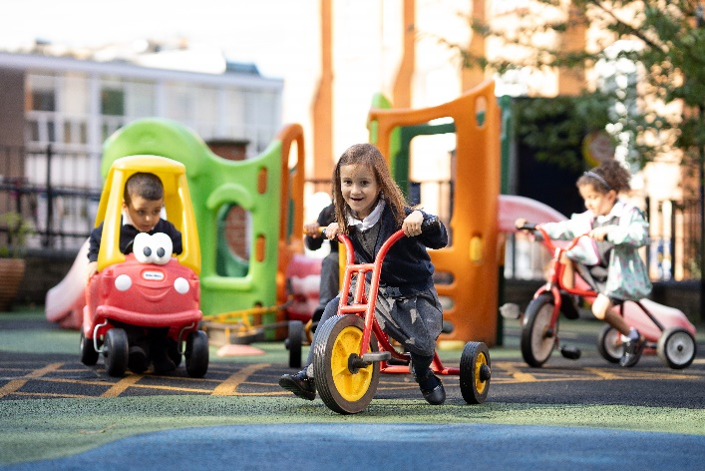
Types of schools
Church Schools (Voluntary aided)
Community schools
Academies
Free Schools
Private/ fee paying schools

Slide 3
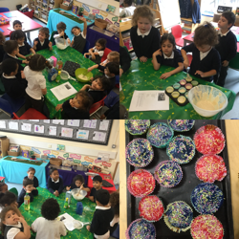
Apply online for your child’s primary school place www.westminster.gov.uk/school-admissions
You apply to the local authority where
you live.
Make 6 choices to schools where you meet the criteria and that you are happy with.
Think about the order of your choices.
Make sure that you complete all
sections of the form.
All information and applications for
Westminster, Brent and Camden
are online.

Slide 4
YOU MUST APPLY FOR A PLACE
Your child may already attend the nursery class of a primary school and you may wish for them to continue onto the Reception class, but you must still apply by the closing date.
There is no priority for a child in the nursery to be offered a place in the Reception class of the same school.
The preferences you make are treated equally.
You will receive only one offer.
The pack you receive today contains an application form and the admissions criteria.

Slide 5
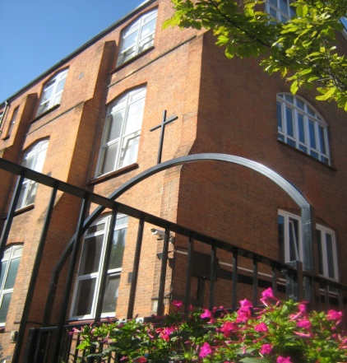
St Augustine’s Church of England Primary School Admissions Criteria
‘Looked after children' or children who were previously looked after, but immediately after being looked after became subject to an adoption, child arrangements or special guardianship order.
Children whose parents or guardians worship regularly at St Augustine’s Church, Kilburn Park Road or another Anglican (Church of England) church.
Children whose parents or guardians worship regularly at another Christian church or chapel which is a member of, or is in association with, Churches Together in England (CTIE) or the Evangelical Alliance.
Children whose parents or guardians live in the local community and attend occasionally St Augustine’s Church, Kilburn Park Road or another Anglican (Church of England) church.
Children whose parents or guardians live in the local community and attend occasionally another Christian church or chapel which is a member of, or is in association with, Churches Together in England (CTIE) or the Evangelical Alliance.
Children who have a brother or sister (including ‘step’ and ‘half’ brothers or sisters) living at the same address, attending St Augustine’s Primary School (that is in Reception or Years 1 to 6, but not in the Nursery) at the closing date for their application for the Reception class.
Children of support and teaching staff who have been employed directly by the school on a permanent contract for at least two years, and who will still be in post at the time of the child’s admission.
Children whose parents or guardians worship regularly at any other Trinitarian Christian denomination.
Children of other faiths whose parents or guardians live in the local community and worship regularly in other places of worship and who would value the education and ethos of a Church School.
Children whose home address is closest to the school.

Slide 6
Church Schools
You must fill in an extra information form as well as the on-line application
You must pick up the form from the school that you want to apply for or at www.westminster.gov.uk/admissions
Make sure that you add the school to your list of preferences
If you have a faith, go to the church, mosque or temple, you must get the supplementary form stamped and signed.
You must be prepared for your child to be part of a Christian community with all that this will entail.

Slide 7
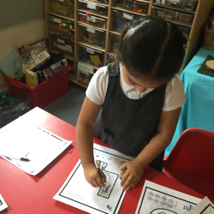
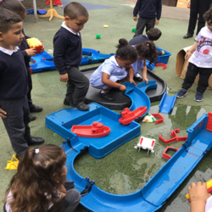
Making a choice
Look at the school website or visit
the school (if possible)
Look at the admissions criteria
Be practical and realistic
Talk to a range of parents, if
possible
Make up your own mind

Slide 8
Completing the forms
Look at the criteria and make sure that you meet them
Start now
Ask for help
Go to your place of worship with the supplementary (extra) form
You can apply from any location with internet access, 24 hours a day, seven days a week, up until the closing date: 11:59pm on 15th January 2025.
During the evening of 16th April 2025 you will be sent an email with the outcome of your application.

Slide 9
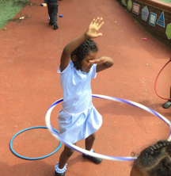
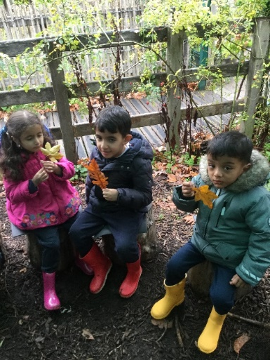
Who will decide who gets a place?
Names and details of those who applied go to schools (parent’s order of preference is not given).
School governors place them in order according to the criteria.
The list is returned to Westminster .
Parents are informed.

Slide 10
What if you are unhappy with the school your child is given?
You can appeal if the school that you wanted has not applied the criteria fairly.
Applications can only be considered on the information given by parents/ carers.
It is important that your child starts school at the right time.

Slide 11
St Augustine’s CE Primary School
A church school with a tradition and expectation of learning and working together.
Attendance on all school days is expected (holidays and appointments must not be booked during term time).
Parent’s workshops take place throughout the year - we expect parents and carers to be an active part of their child’s learning.
Sibling details and faith letters must be
completed and authorised by the
deadline so they can be considered.

Slide 12
IMPORTANT DATES
MUST BE COMPLETED BY
11.59 p.m. on 15th January 2025
(to Westminster, Brent or Camden)
You will know on
16th April 2025
Term starts at the beginning of September 2025 so do not book a holiday during this time

Slide 13
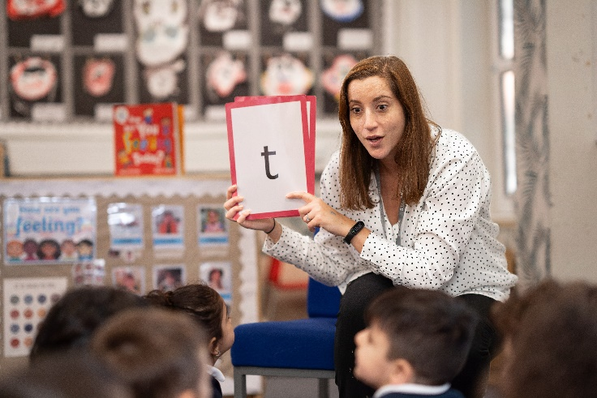
IF YOU NEED HELP APPLYING OR HAVE ANY QUESTIONS…
You can contact our School Office Manager, Linda Wiggins, on
0207 328 0221
Or speak to the Nursery class team

